Slide 1
Innovation and business intelligence indicators
Irene Kitsara
IP Information Officer, Access to Information and Knowledge Division

Slide 2

What is used as an innovation indicator?
Innovation types:
product, process, organizational & marketing innovation
Patent data: innovation output indicator

Slide 3

Patent-based indicators
Patent classifications (technology, companies, organization types)
Patent citations
Internationalization of S&T
Patent value

Slide 4
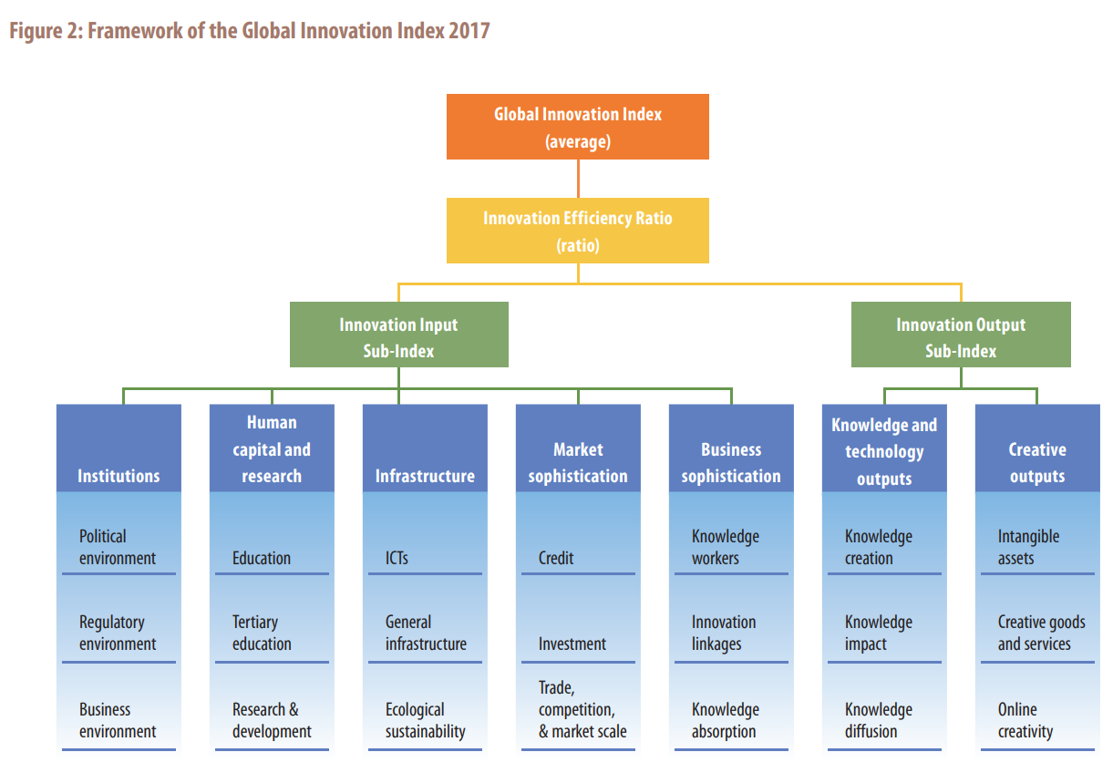

Global Innovation Index (GII)
www.wipo.int/edocs/pubdocs/en/wipo_pub_gii_2017.pdf

Slide 5
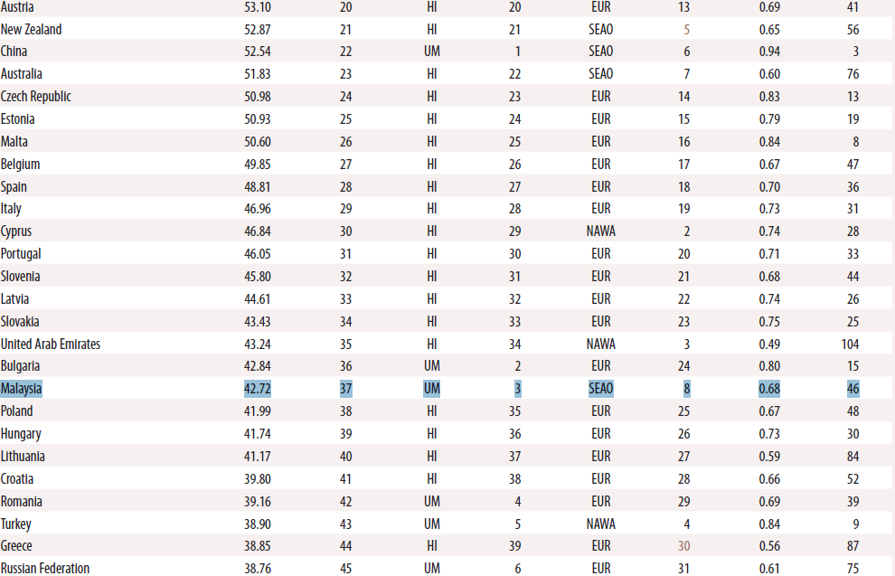
How is Malaysia doing ?

Slide 6
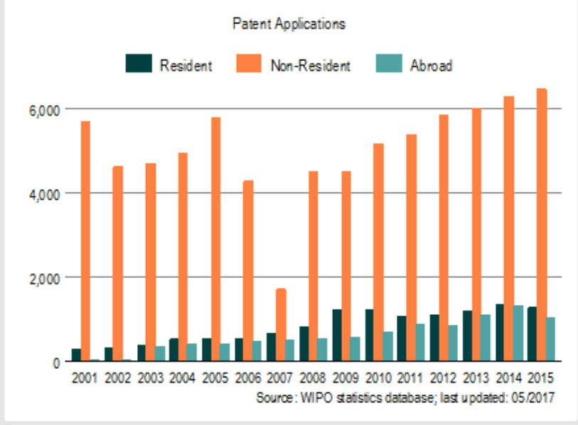
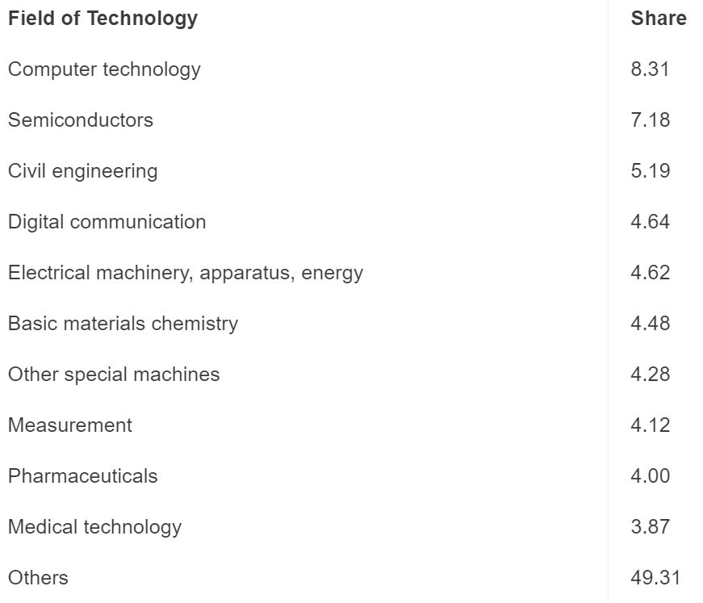
How is Malaysia doing?

Slide 7
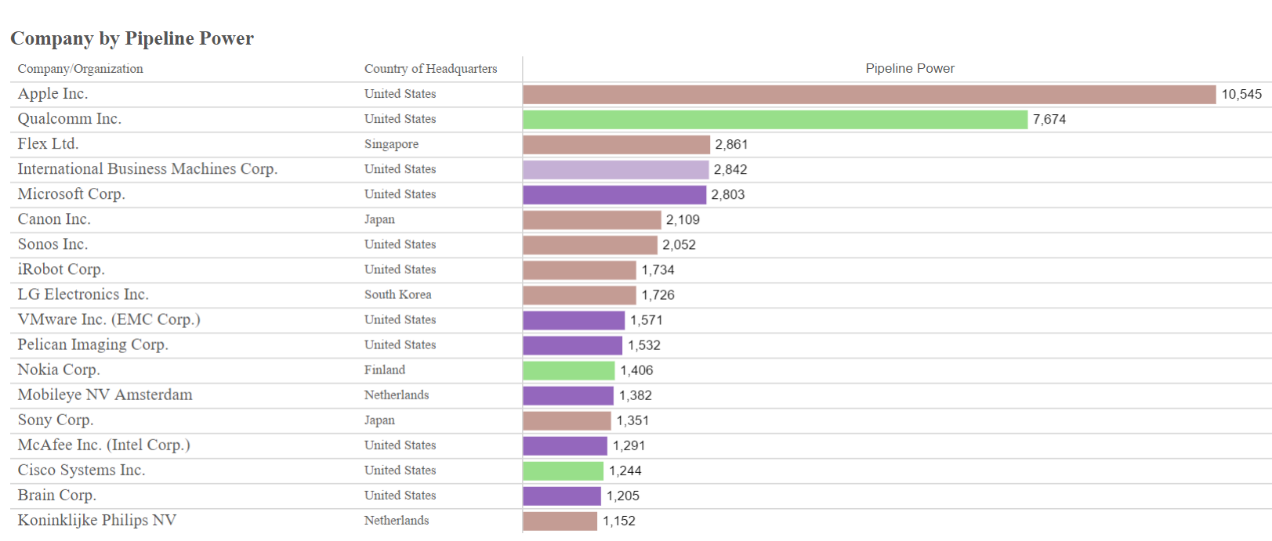
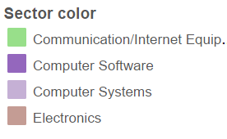
Companies patent portfolio and how they influence their sector
Source: IEEE Spectrum Patent Power Scorecards 2016
http://spectrum.ieee.org/static/interactive-patent-power-2016

Slide 8
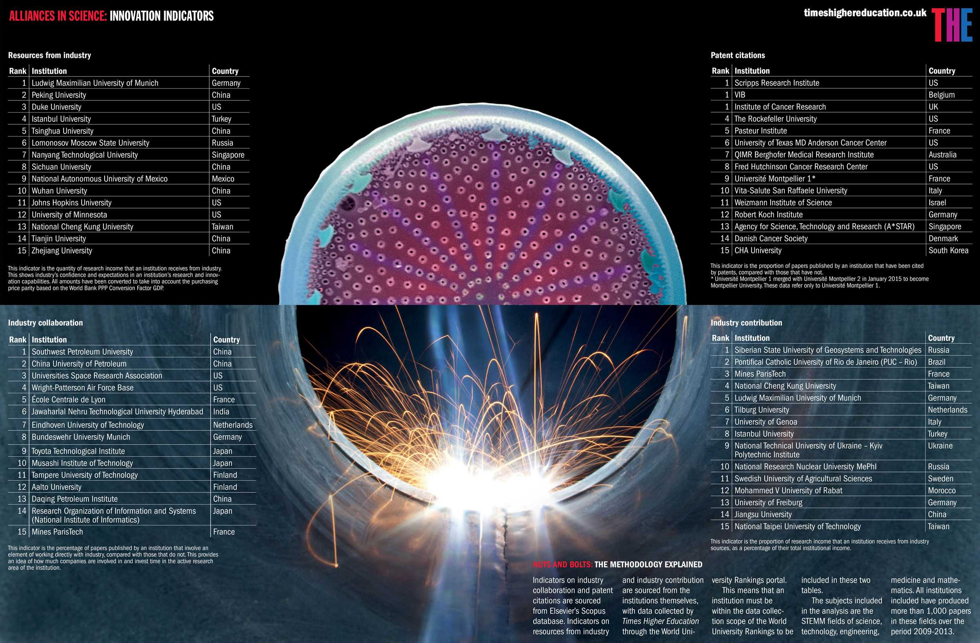
Decisions that lead to collaborations

Slide 9
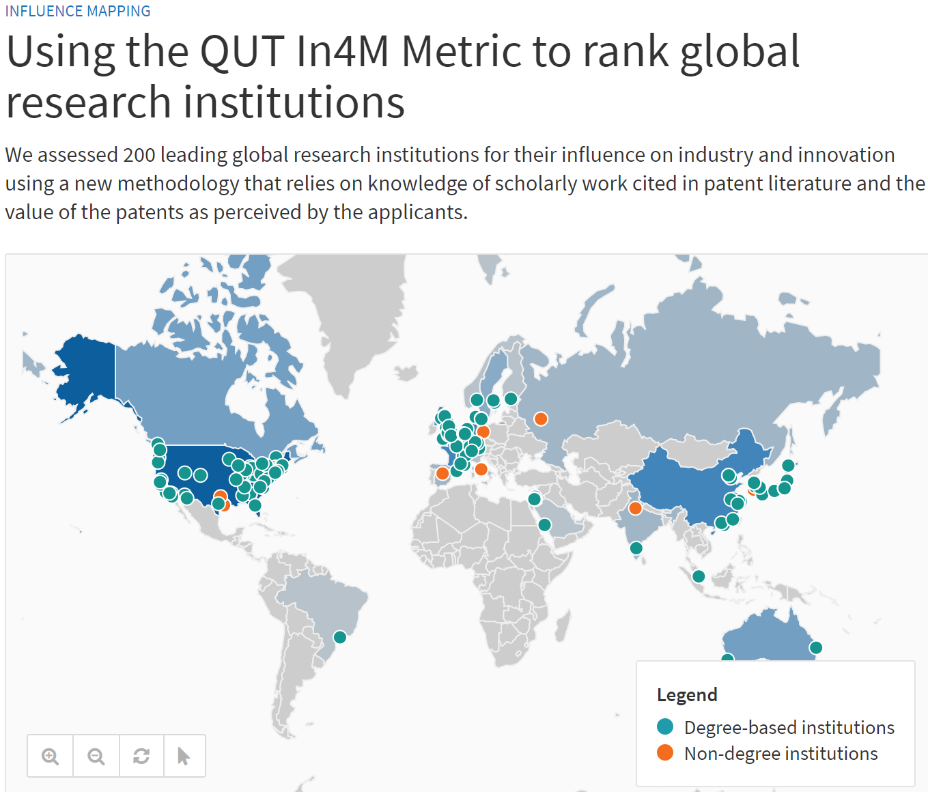

Slide 10
Some initial thoughts
What can we measure?
What is the value of measuring?
Co-relation does not mean causation

Slide 11
Patent Information: what is measurable
Patent Documents
Publication/Application Numbers – which one and why?
Applicants
Inventors
Patent Classification
Citations
Other types of patent/business information
Legal Status Events
Change of ownership
Corporate trees/ afiliations
Licensing
Litigation

Slide 12
What kind of analysis can be included in a Patent Landscape Report?

Slide 13
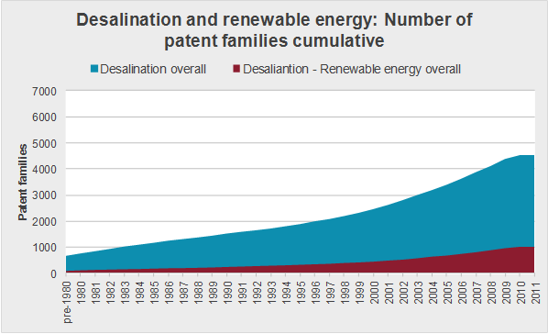
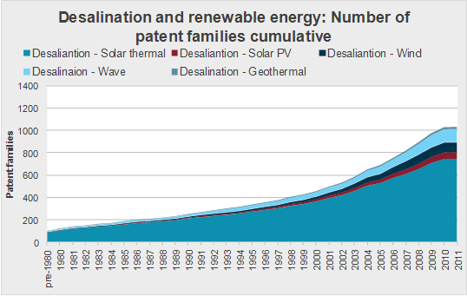
General trends vs. trends in subsectors
Source: WIPO PLR on Water desalination and the use of renewable energies
Help identify promising, emerging or saturated technology areas
Identification of potential niche technologies

Slide 14
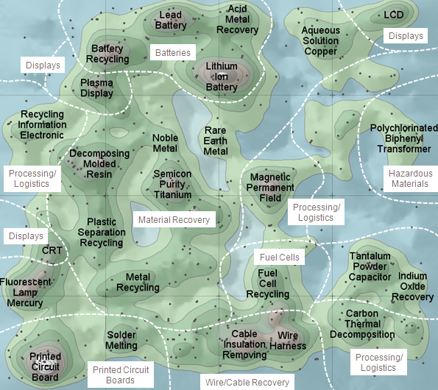
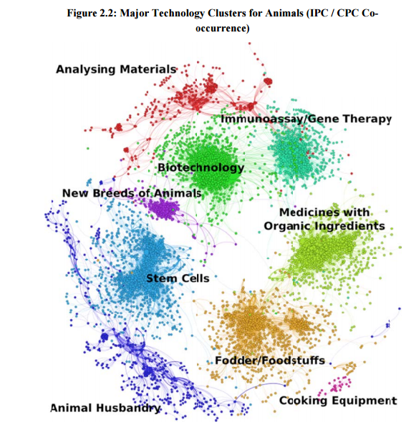
Clustering of prominent technology areas
Network mapping in Animal Genetic Resources PLR
Thematic Concept (Themescape) of E-Waste Landscape

Slide 15
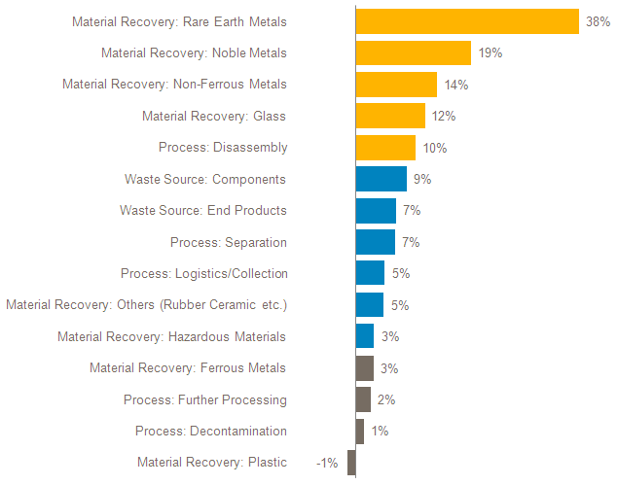
Annual Growth rate in patent filing areas – indicators of other trends and changes in market/jurisdiction
Patenting Activity Trends in E-waste by Subject Matter; Annual Growth/Decline 2006-2010 (based on Earliest Year of First Filing)

Slide 16
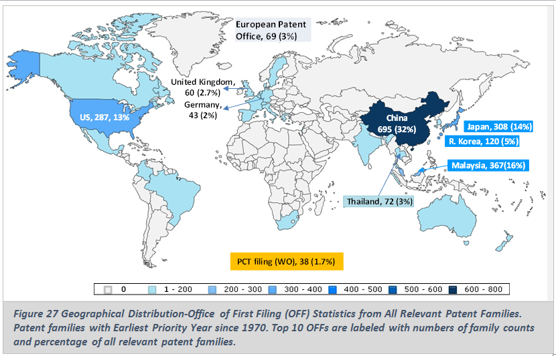
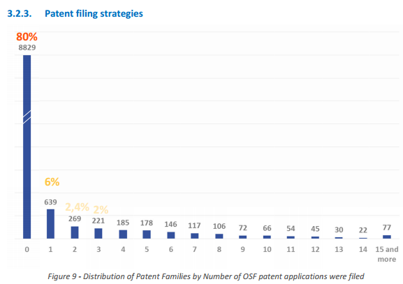
Geographical distribution of patent protection
General trends (OFF)
Patent filing strategies (OSF)
Source: WIPO PLR on Palm Oil
Source: WIPO PLR on Microalgae

Slide 17
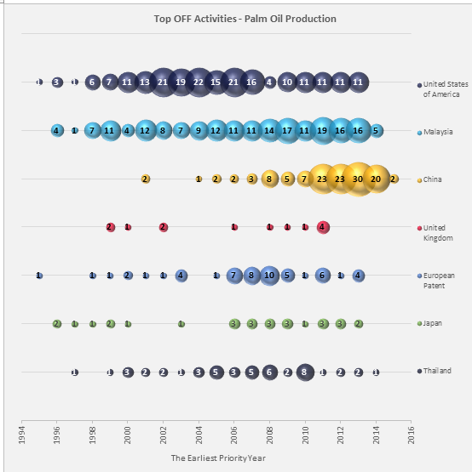
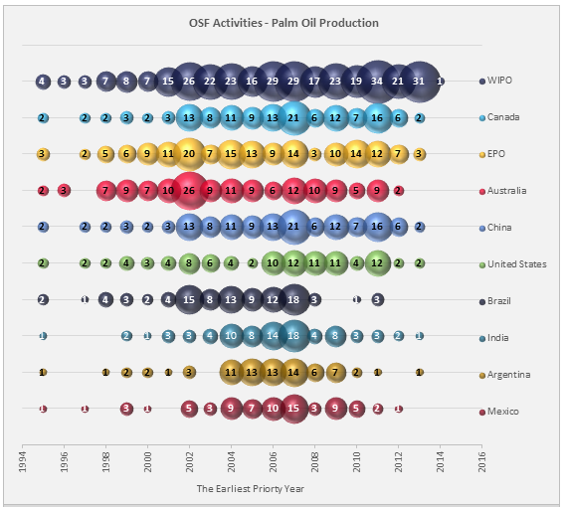
OFF and OSF as indicators of innovation and potential market
Top OFF – Filings over time
Top OSF – Indirect market analysis

Slide 18
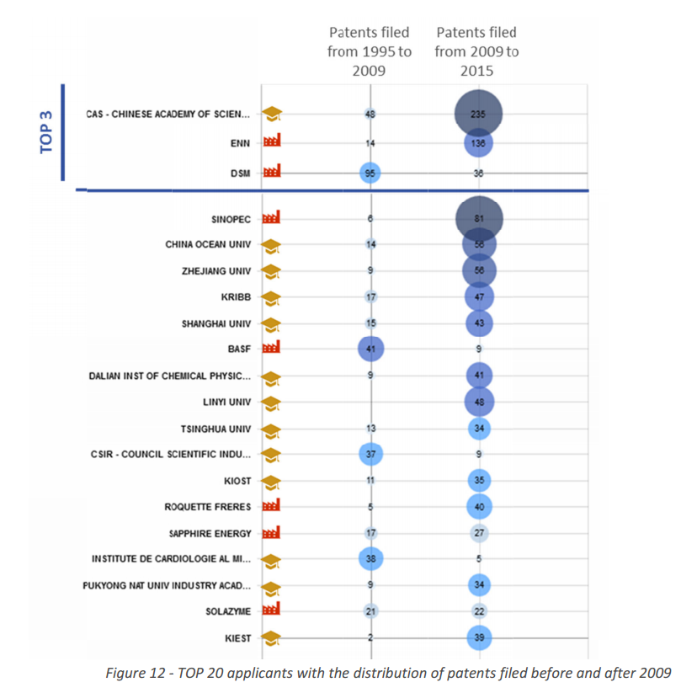
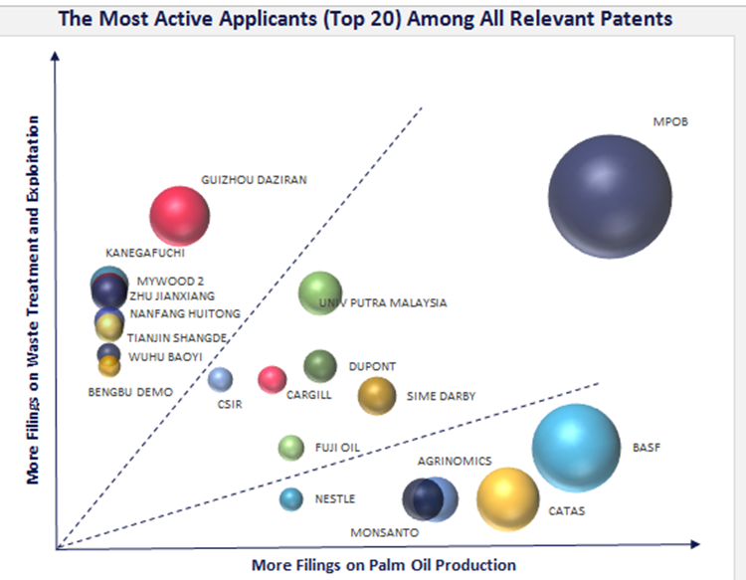
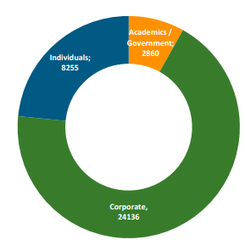
Major players in a field, profile, new players, change in focus and strategy
Key players, profile, recent activity
Key players focus areas
WIPO PLR on Palm Oil
WIPO PLR on Microalgae
WIPO PLR on Assistive Devices for Visually and Hearing Impaired Persons

Slide 19
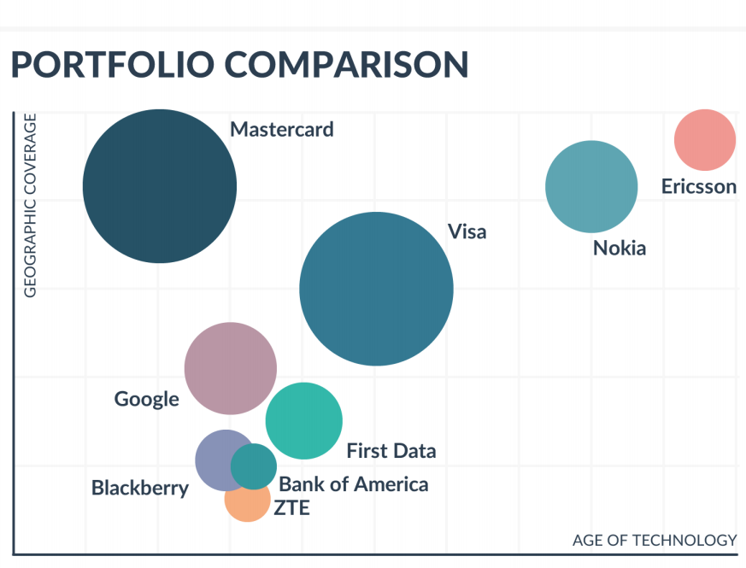
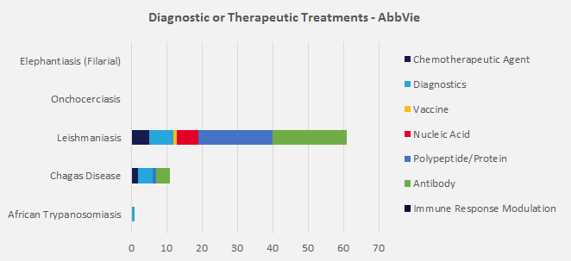
Specific applicants analysis
Applicant focus and portfolio
Geographical coverage and age of technology
WIPO Selected Neglected Diseases PLR

Slide 20
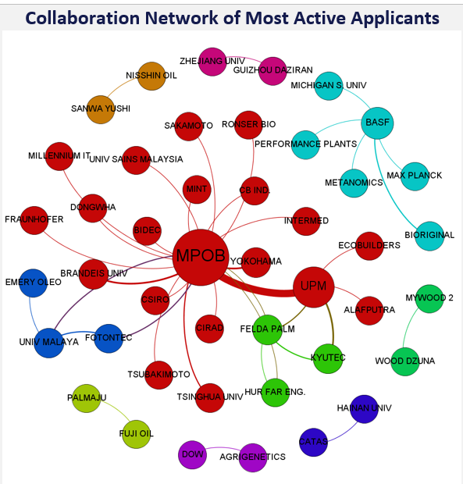
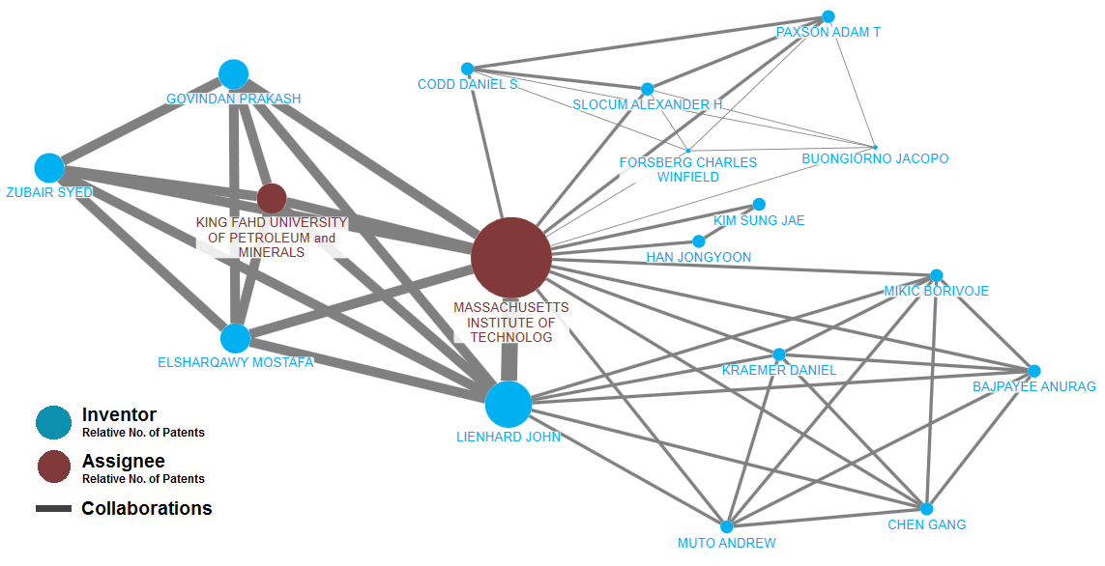
Co-assignments and collaboration networks
Co-assignments – applicants collaboration networks
Applicant-inventors collaboration network
WIPO Palm Oil Production PLR
WIPO Desalination PLR

Slide 21
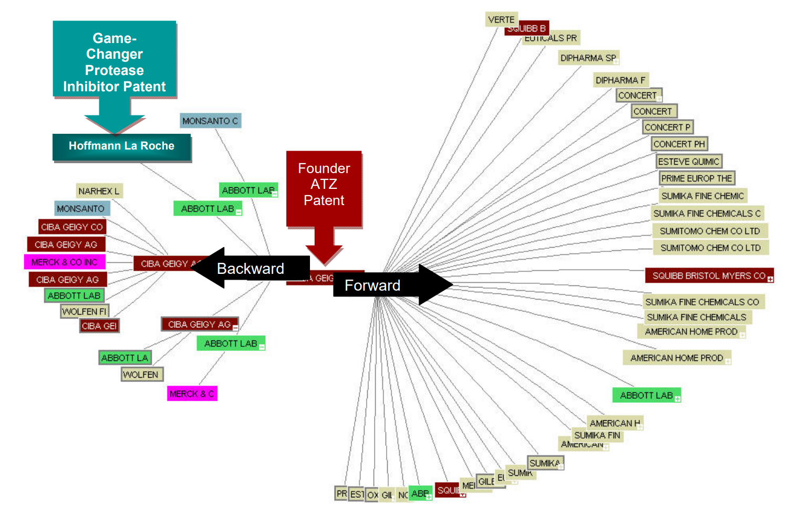
Citation analysis/network
Source:WIPO PLR on Atazanavir
Forward citations: impact of an invention/patent
Backward citations: assessment of degree of novelty

Slide 22

Matching patents to products
Source: WIPO PLR on Solar Cooking

Slide 23
Combining patent with non-patent data
Source: IEA, Energy Technology R&D Statistics 2007
R&D in- and output, patenting activity as indicator of innovation

Slide 24
What do patent counts tell us? Perceptions & caveats
Differences across jurisdictions (patentable subject matter, backlogs, incentives to file a patent, examination quality)
Differences across cultures (patenting activity just one indicator of innovation)
Particularities of technology areas
Existing and missing counts (availability of data)
Difference in filing strategies and practices across areas of technology
Who are the dominant players? Real picture (corporate trees, M&As, afiliations of individuals to companies)
Different filing strategies based on size of companies (e.g. economies mainly with SMEs)

Slide 27
Irene.Kitsara@wipo.int

